Slide 1
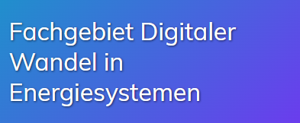
Advancing research at the intersection of wind energy and the geophysical sciences
8 May 2024
Ken Caldeira
kcaldeira@carnegiescience.edu Carnegie Institution for Science, Dept. of Global Ecology Gates Ventures

Slide 2
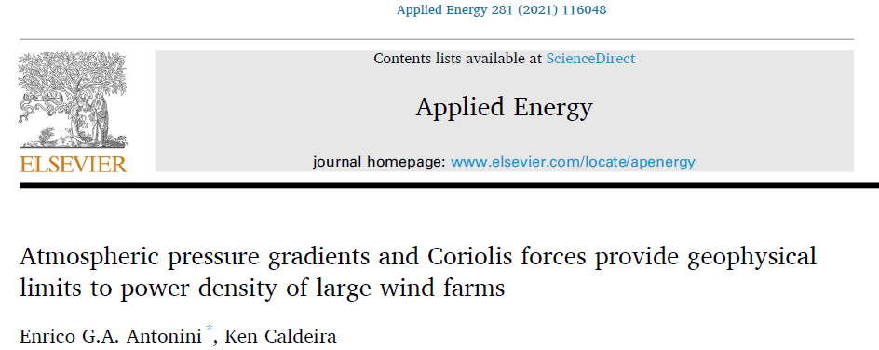
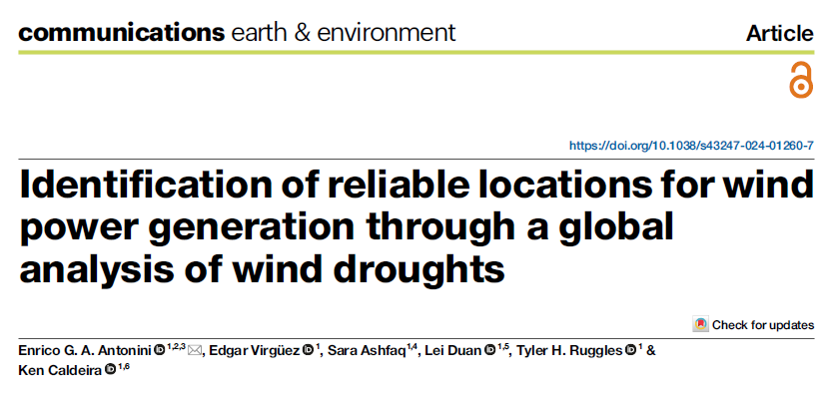
2012
2021
2017
2021
2024
2017

Slide 3
We distributed representations of wind turbines, at different densities,
Across the entire surface of the Earth
Throughout the volume of the atmosphere
How much power can be produced?
What are the effects on climate?
I would like to hire a postdoc to continue this work, looking at smaller spatial scales.

Slide 4
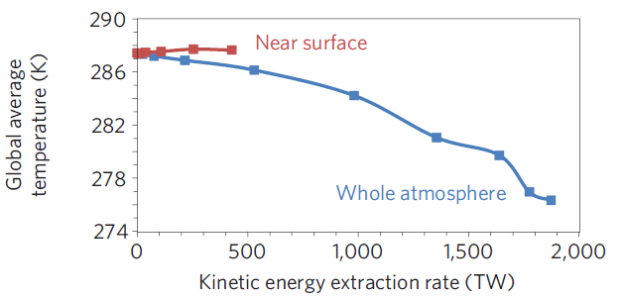
Geophysical potential: Near surface > 400 TW
Whole atmosphere > 1800 TW

Slide 5
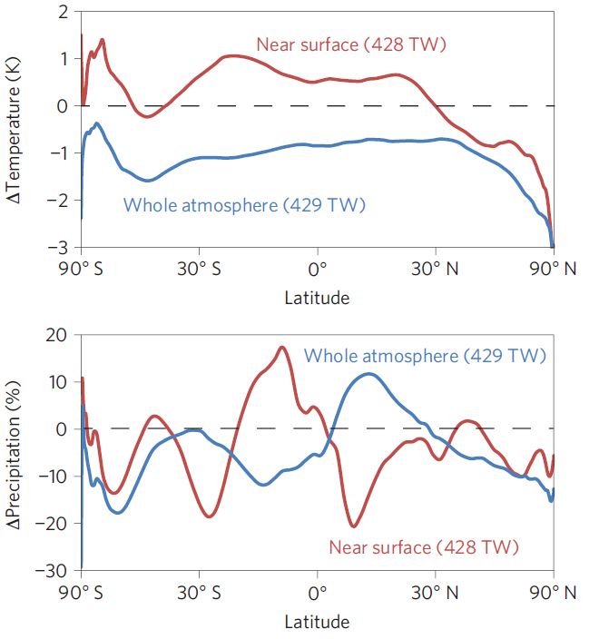
Zonal mean temperature changes are < 0.1 K/TW Zonal mean precipitation changes are < 0.1%/TW

Slide 6
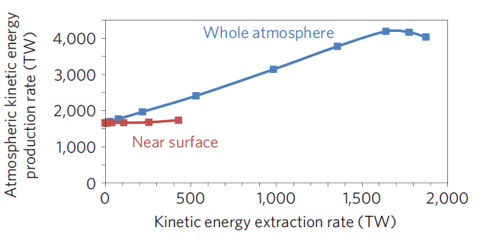
Wind turbines near surface affect where kinetic energy gets dissipated. High-altitude wind turbines affect how much kinetic energy gets produced and dissipated.

Slide 7
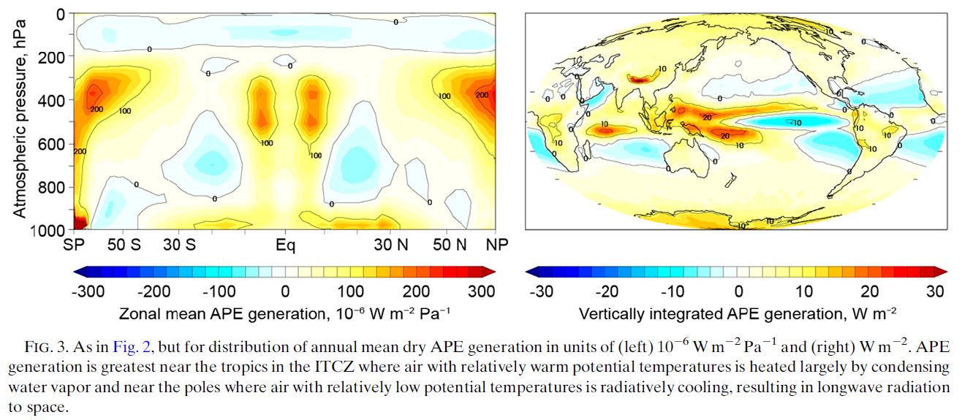

Slide 8
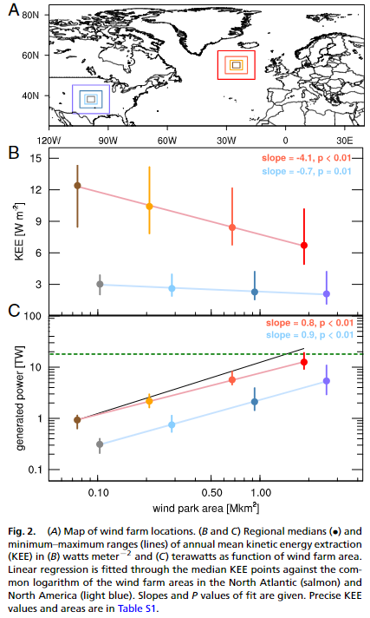
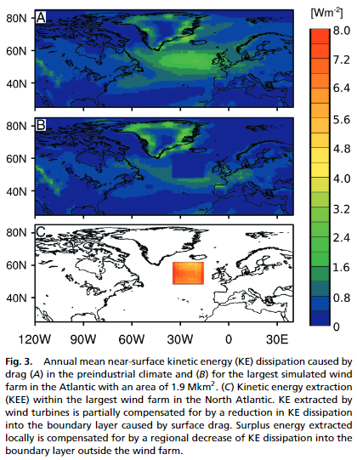
About ~10 W/m² for the best parts of the North Atlantic compared with 2 or 3 W/m² for the best parts of North America.

Slide 9
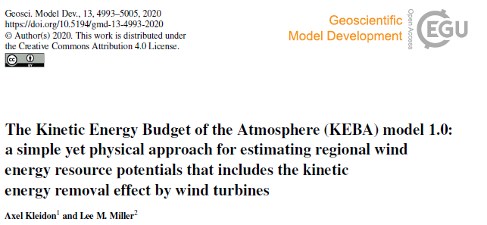
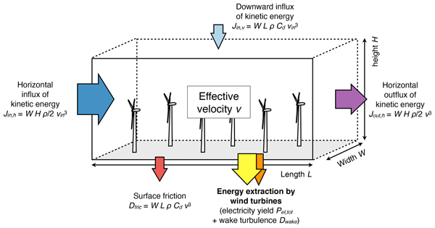
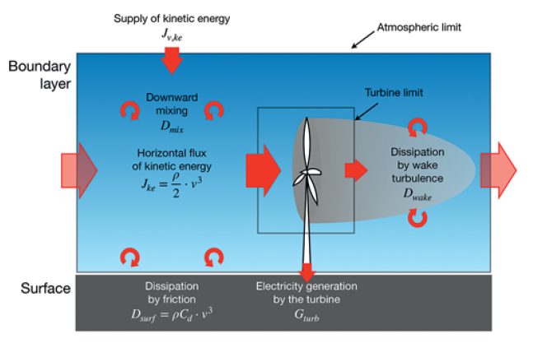
An incorrect view that I shared: Kinetic energy removed from the near-surface boundary is replenished by a downward influx of kinetic energy from above.

Slide 10
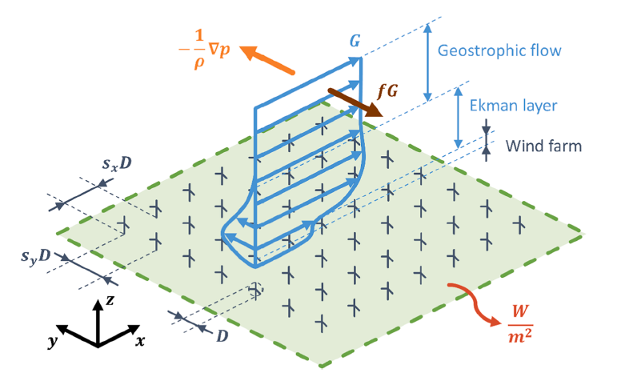
A better perspective: 1. Near surface winds represent a balance between pressure gradient forces and (apparent) Coriolis forces.
2. When winds are slowed by wind turbines, Coriolis forces diminishes, result in an acceleration of air parcels by large-scale pressure gradient forces.
3. Thus, kinetic energy removed from the atmosphere is replaced by large-scale potential energy gradients in the atmosphere.

Slide 11
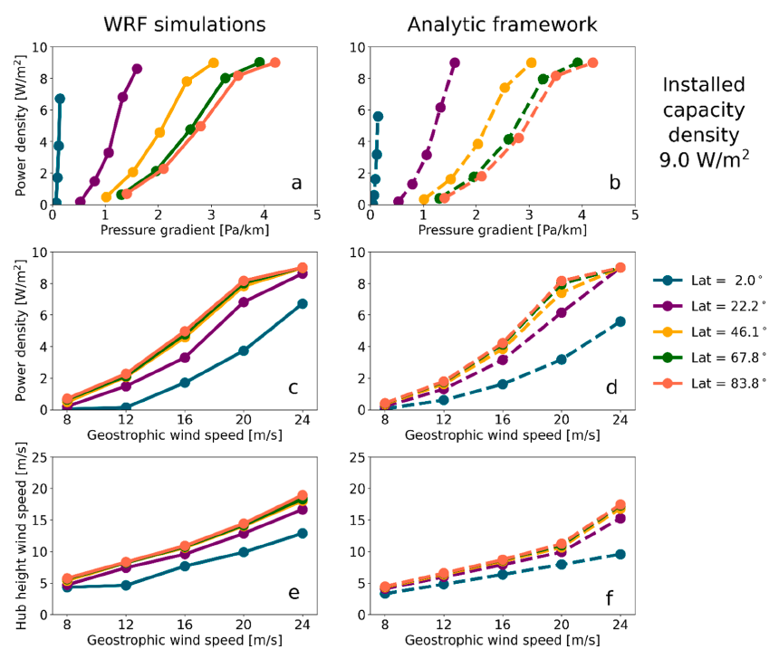
An analytic framework based on well-established theory produces results that are largely in agreement with results from fluid-dynamical model simulations.

Slide 12
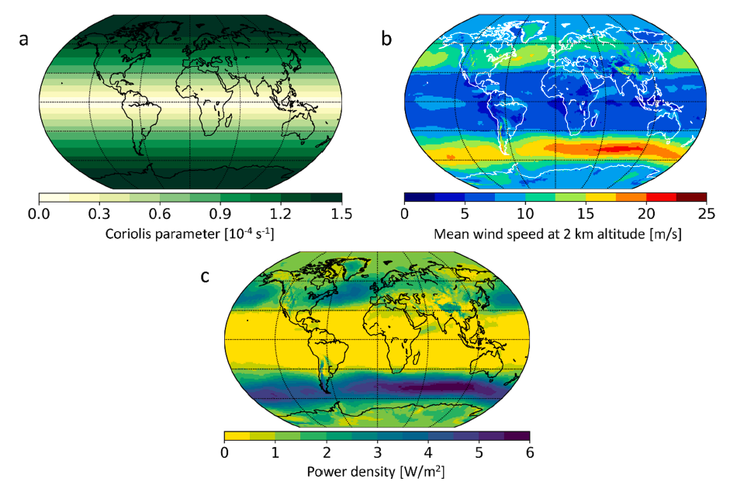
Maximum wind power extraction (at large scale!) can be estimated from the Coriolis parameter and the strength of the geostrophic winds.

Slide 13
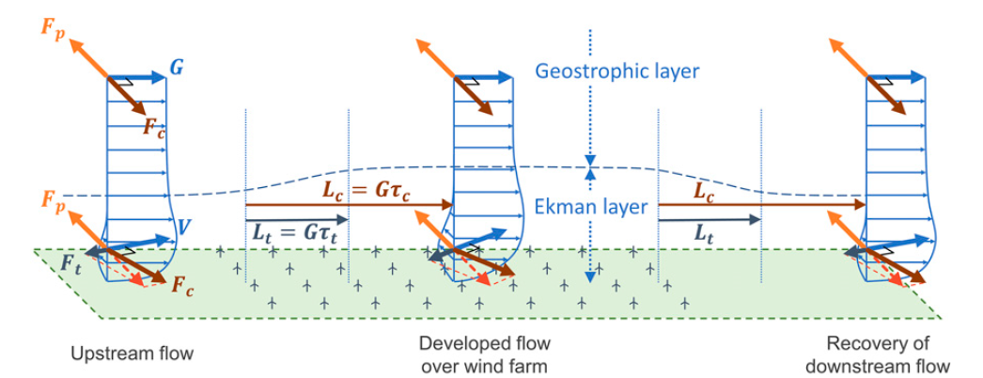
$$L∝\frac{G}{f}∝\frac{\frac{dΦ}{dx}}{f}$$
Transition length scale (L) is proportional to: geostrophic winds (G) divided by Coriolis parameter (f), which is proportional to the horizontal pressure gradient (d Ф / d x) divided by the Coriolis parameter (f).

Slide 14
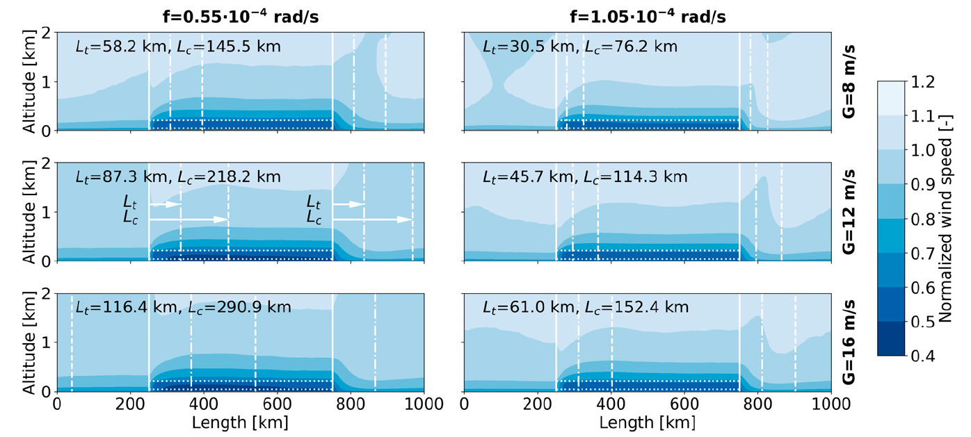
Latitude 22°
Latitude 46°
$$L∝\frac{G}{f}∝\frac{\frac{dΦ}{dx}}{f}$$

Slide 15
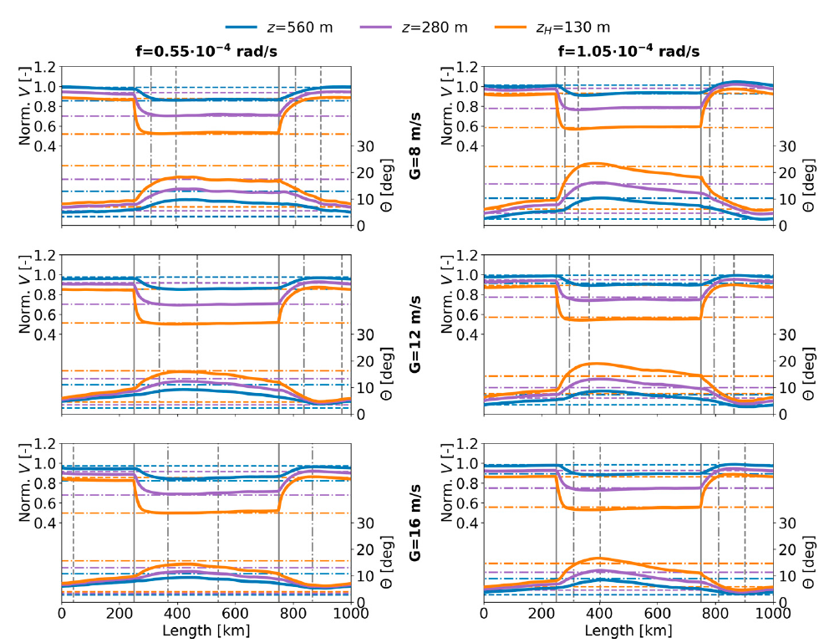
Latitude 22°
Latitude 46°
Wind speeds at hub height drop to ~0.6 by the turbulent length scale, which means wind power drops by 80%.

Slide 16
What can we usefully say about wind resources from a purely geophysical perspective, without taking cost, current demand, etc, into consideration?
Goal: Identify locations with –
High mean wind-power density
Low seasonal variability
Low weather variability
How do we reasonably combine disparate metrics (power density, variability) into a single metric?

Slide 17
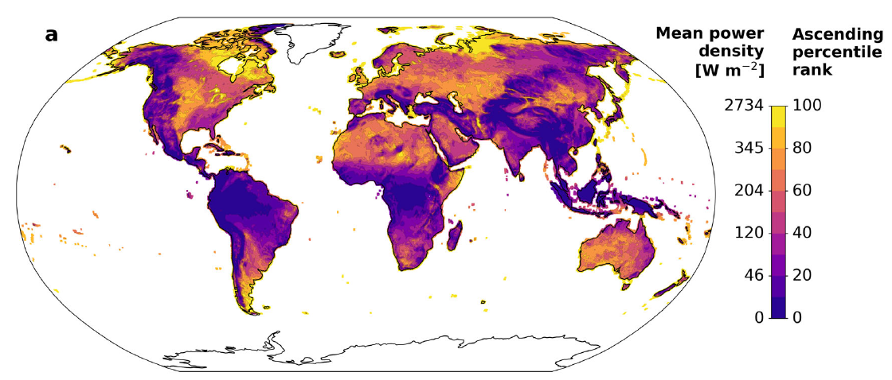
Power density
27.34
3.45
2.04
1.20
0.46

Slide 18
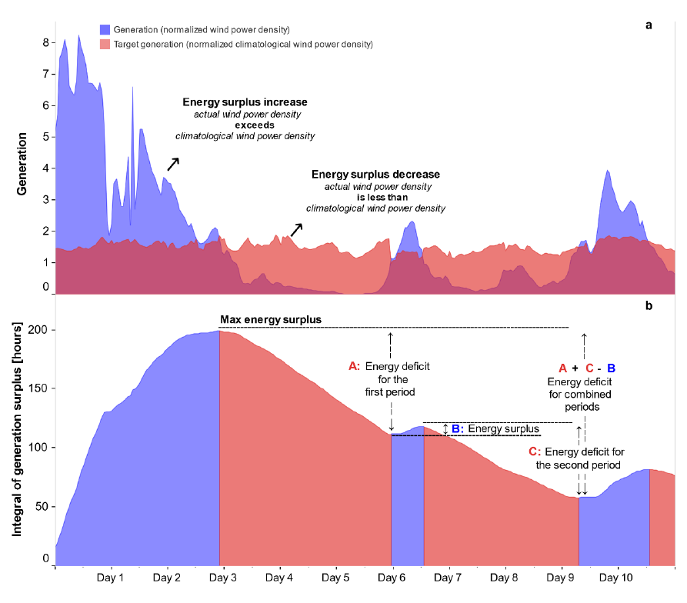
Energy deficit variability metrics
Seasonal variability Difference between hourly climatological average wind power and constant mean average
Weather variability Difference between hourly reanalysis wind power and hourly climatological averages

Slide 19
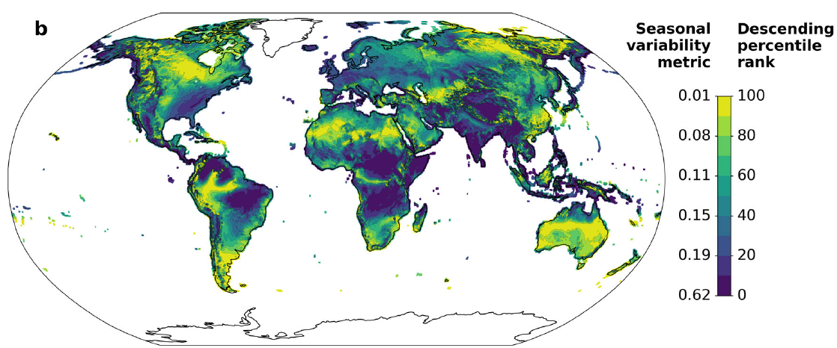
Seasonal variability

Slide 20
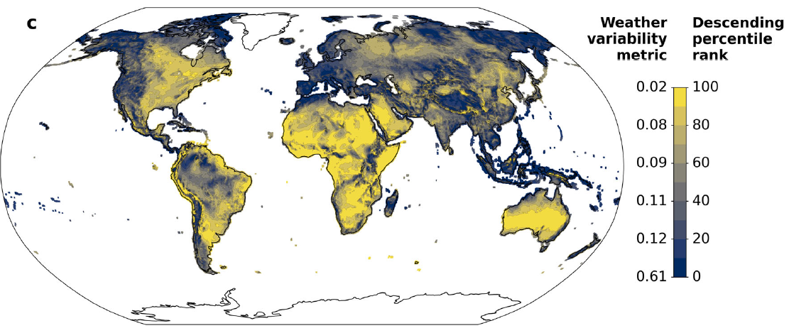
Weather variability

Slide 22
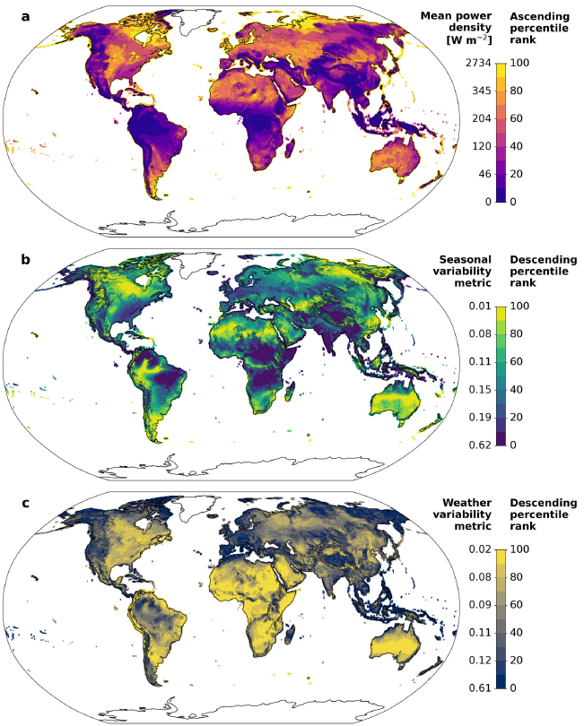

Slide 23
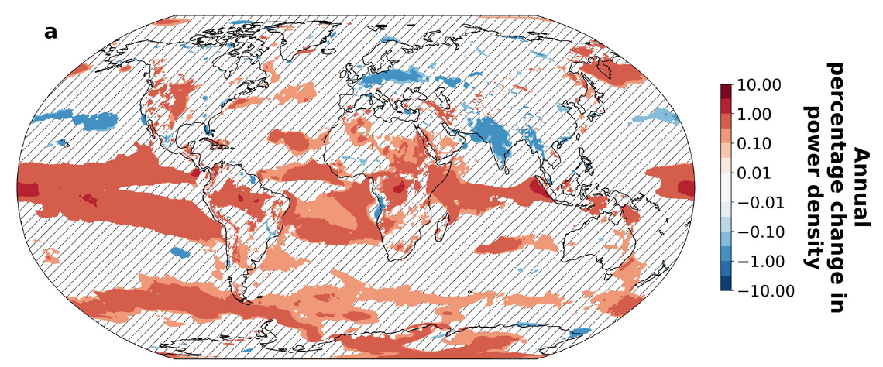
Historical temporal trends in power density

Slide 24
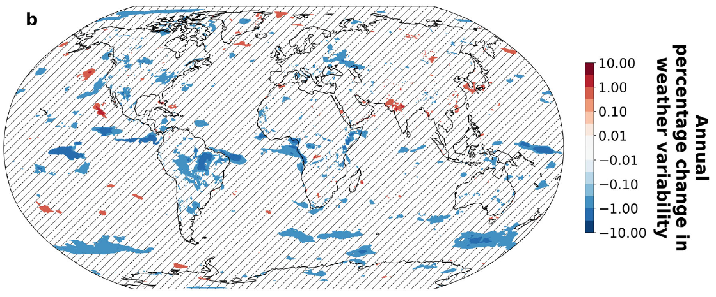
Historical temporal trends in weather variability

Slide 25
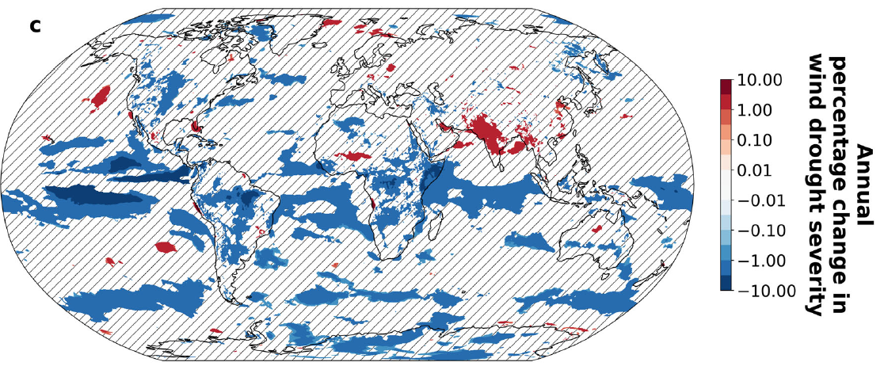
Historical temporal trends in wind drought severity

Slide 26
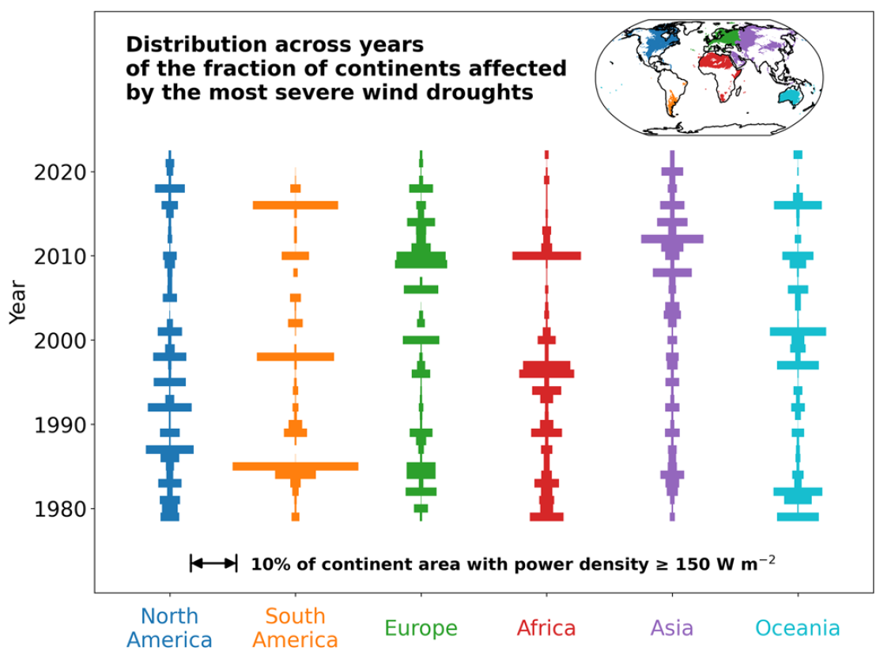
Historical temporal trends in wind drought area
1.50 W m⁻²

Slide 27
2012
2021
Thanks to Kate Marvel, Eva Ahbe, Anna Possner, and, especially, Enrico Antonini, for advancing this research at the intersection of wind energy and the geophysical sciences (and thanks Gates Ventures for funding)
2017
2021
2024
2017

Slide 28
Conclusions
There are a lot of places with strong, reliable winds, but not everywhere
At regional scale in good places, 2 W/m² = 2 MW/km² is a reasonable expectation
This value is limited by the ability of large-scale pressure forces to replenish energy removed by wind turbines The length scale for replenishment is proportional to wind speeds and inversely proportional to the Coriolis parameter (and so shorter at high latitudes), but is typically some 10s of km

Slide 29
2012
2021
https://www.nature.com/articles/nclimate1683
https://www.sciencedirect.com/science/article/abs/pii/S0306261920314835
2017
2021
https://journals.ametsoc.org/view/journals/clim/30/6/jcli-d-15-0614.1.xml
https://www.pnas.org/doi/abs/10.1073/pnas.2103875118
2024
2017
https://www.pnas.org/doi/full/10.1073/pnas.1705710114
https://www.nature.com/articles/s43247-024-01260-7

