Slide 1
A historical approach to climate science
Early investigations to first warnings
Ken Caldeira
5 April 2024
kcaldeira@carnegiescience.edu

Slide 2
The modern view

Slide 3
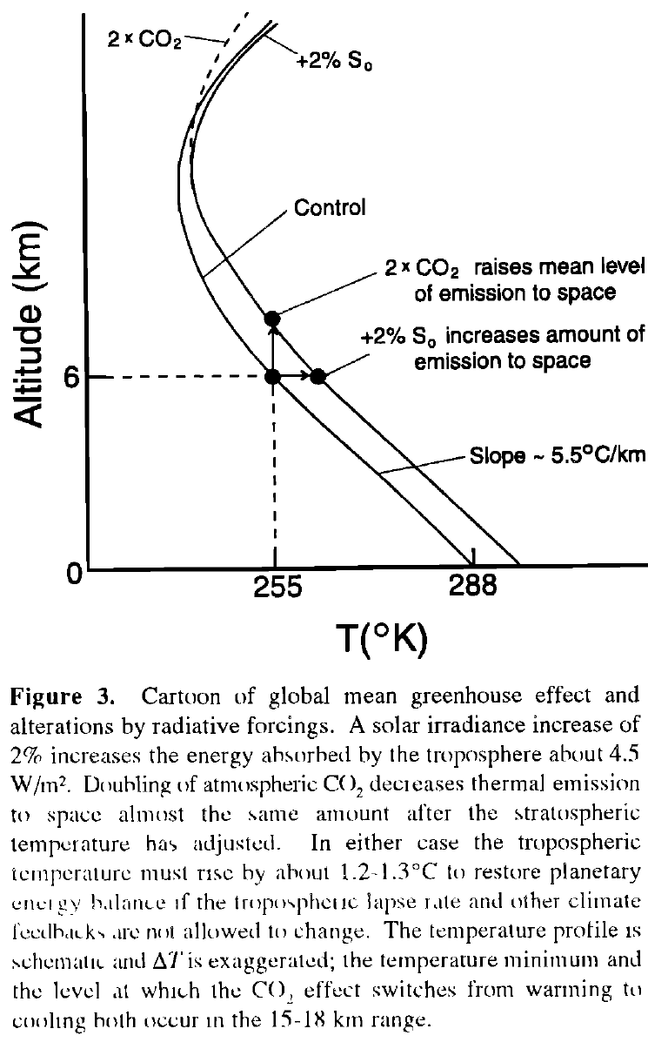
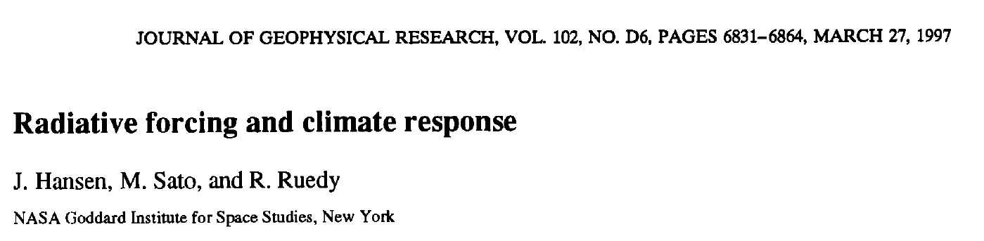
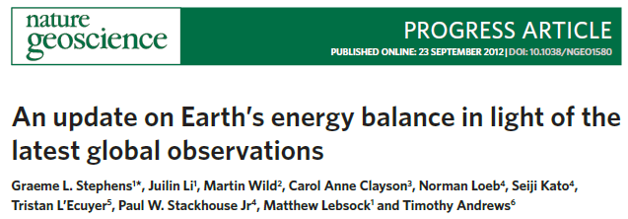
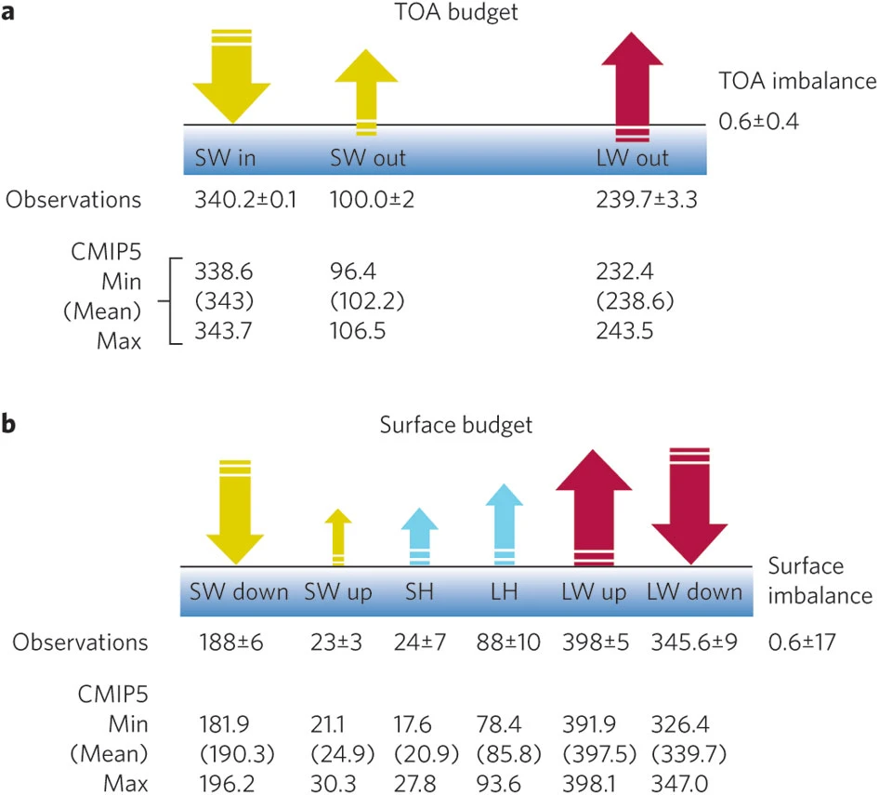
Top of atmosphere budget

Slide 4
A historical approach to climate science

Slide 5
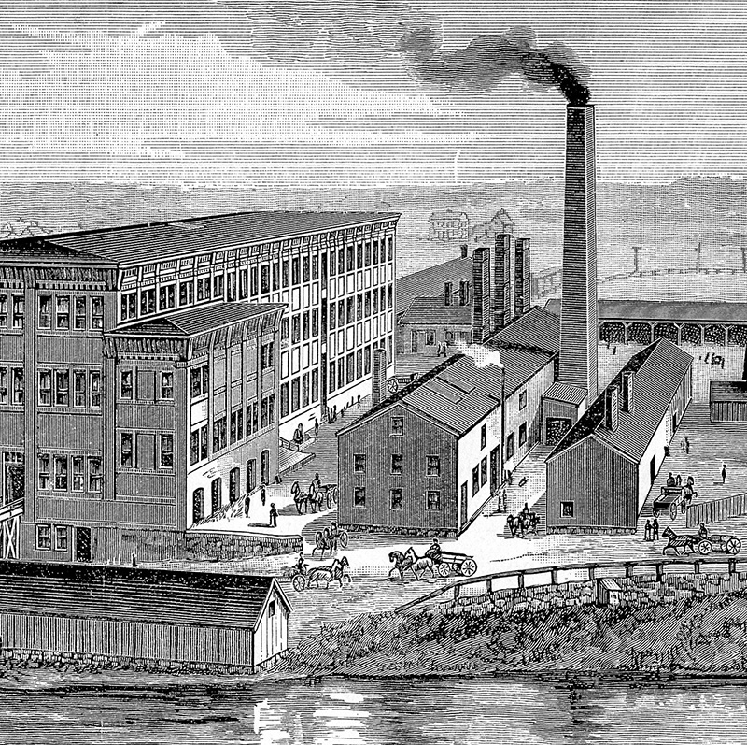
1760
Since the start of the Industrial Revolution, the way people live and work has changed dramatically as manufacturing expanded. Over time, the amount of fossil fuels burned increased, which has increased the amount of carbon dioxide (CO₂) in the atmosphere . Before the Industrial Revolution, there was approximately 280 parts per million (ppm) of CO₂ in the air. Today, that amount is over 400 ppm.
INDUSTRIAL REVOLUTION BEGINS
https://scied.ucar.edu/learning-zone/how-climate-works/history-climate-science-research

Slide 6
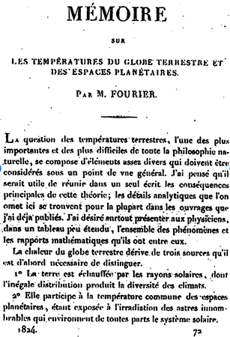
1824
Jean-Baptiste-Joseph Fourier, a mathematician working for Napoleon, was the first to describe how Earth’s atmosphere retains warmth on what would otherwise be a very cold planet.. To help explain the concept, he compared the atmosphere to the glass walls of a greenhouse.
DESCRIBING EARTH’S ATMOSPHERE AS A GREENHOUSE
https://scied.ucar.edu/learning-zone/how-climate-works/history-climate-science-research

Slide 7
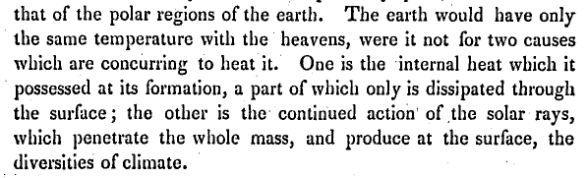

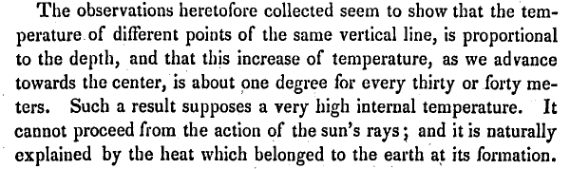
FOURIER 1824:
EARTH HEATED PRIMARILY BY THE SUN
HEAT FROM EARTH’S INTERIOR HAS LITTLE INFLUENCE
THE HEAT IN THE INTERIOR OF THE EARTH DOES NOT COME FROM THE SUN.
(LEFT OVER FROM EARTH’S FORMATION.)

Slide 8
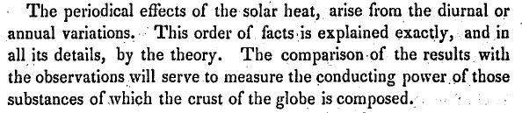
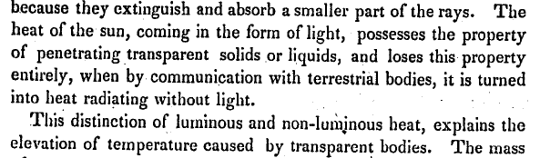
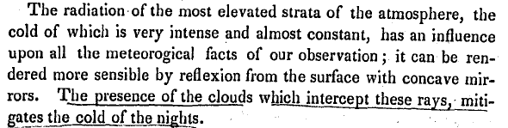
FOURIER 1824:
VARIATIONS IN SUNLIGHT EXPLAIN DAY-NIGHT TEMPERATURE DIFFERENCES AND THE SEASONS
THE ATMOSPHERE MODIFIES THE EFFECTS OF THE SUN’S HEATING
TWO KINDS OF RADIATION (SHORTWAVE AND LONGWAVE)
CLOUDS INTERCEPT LONGWAVE RADIATION,
MITIGATING THE COLD OF NIGHTS
Fourier, 1824

Slide 9
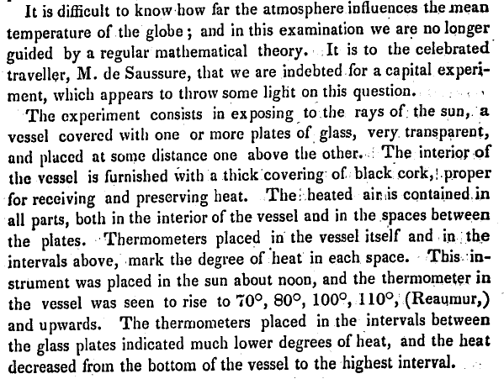
FOURIER 1824:
EARTH’S ATMOSPHERE OPERATES LIKE A GREENHOUSE WITH SEVERAL LAYERS OF GLASS.
(THIS EXPLAINS WHY THE LOWER ATMOSPHERE IS HOTTER THAN THE UPPER ATMOSPHERE.)
Fourier, 1824

Slide 10
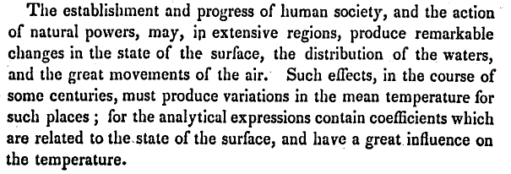
FOURIER 1824:
HUMAN ACTIVITIES MAY AFFECT CLIMATE
SUNLIGHT STRIKES THE EARTH .
THIS ENERGY IS CONVERTED TO LONGWAVE RADIATION.
Fourier, 1824

Slide 11
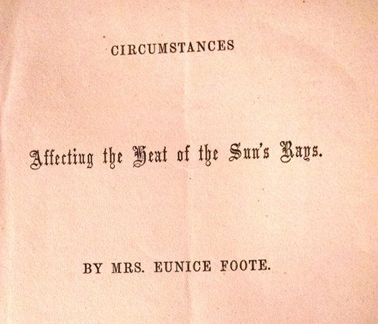
1856
Eunice Foote, American scientist, discovered that carbon dioxide and water vapor cause air to warm in sunlight. In 1856, she presented her findings at the meeting of the American Association for the Advancement of Science (AAAS).
DISCOVERING GASES THAT TRAP HEAT
https://scied.ucar.edu/learning-zone/how-climate-works/history-climate-science-research

Slide 12
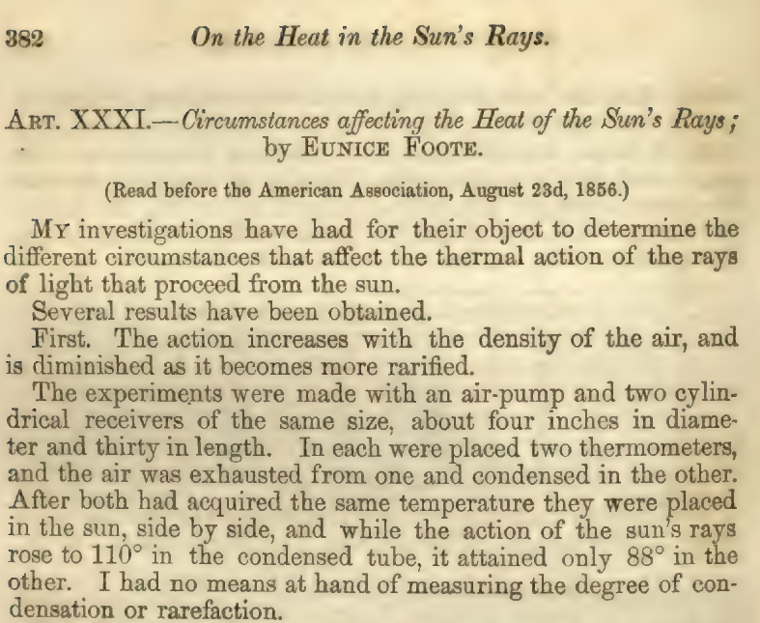
FOOTe 1856:
Air ABSORBS RADIANT ENERGY

Slide 13
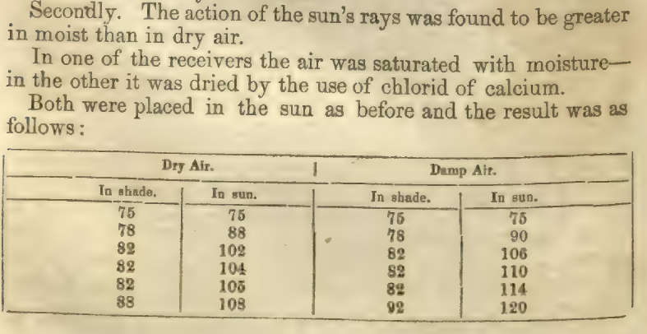
FOOTe 1856:
MOIST AIR ABSORBS MORE ENERGY
THAN DRY AIR

Slide 14
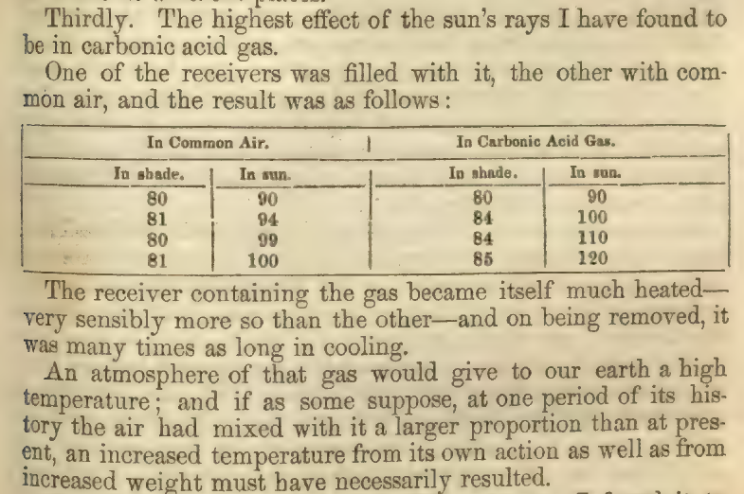
FOOTe 1856:
CO2 IS A STRONG ABSORBER oF
RADIANT ENERGY IN THE ATMOSPHERE
https://youtu.be/SnYMUMoo3E0?t=152

Slide 15
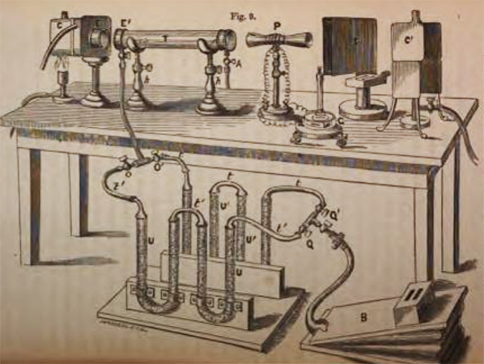
1859
John Tyndall, British physicist, tested the gases in the atmosphere to find out which are responsible for the greenhouse effect. He found that nitrogen and oxygen, which make up almost all of the atmosphere, have no ability to trap heat, but that three gases present in smaller quantities do: carbon dioxide, ozone, and water vapor. Tyndall speculated that if the amounts of these gases dropped, it would chill the Earth.
TESTING THE HEAT-TRAPPING ABILITY OF GASES
https://scied.ucar.edu/learning-zone/how-climate-works/history-climate-science-research

Slide 16
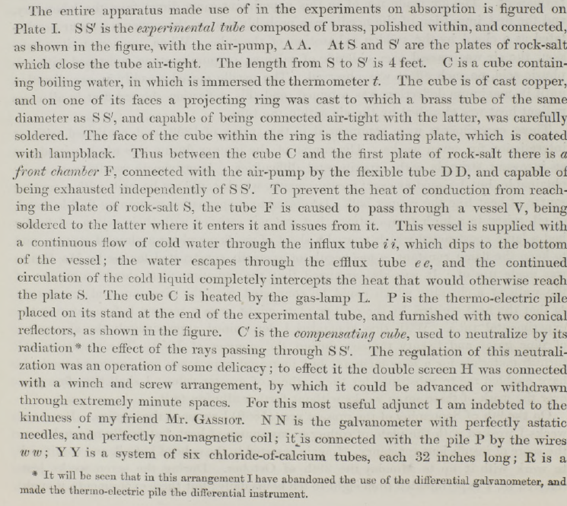
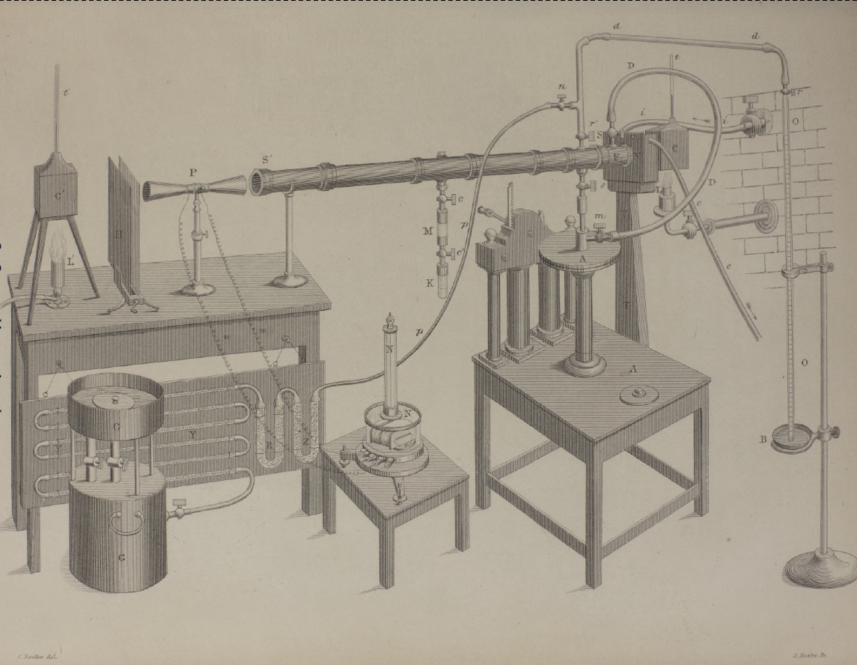
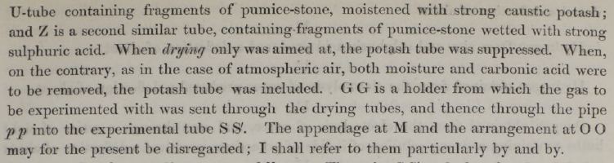
TYNDALL 1859:
APPARATUS TO MEASURE ABSOROPTION
OF LONGWAVE RADIATION
BY GASES

Slide 17
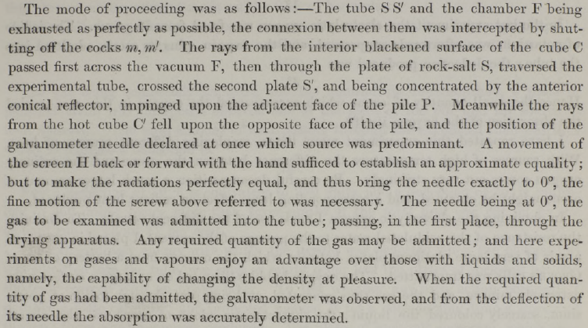
TYNDALL 1859:
APPARATUS TO MEASURE ABSOROPTION
OF LONGWAVE RADIATION
BY GASES

Slide 18
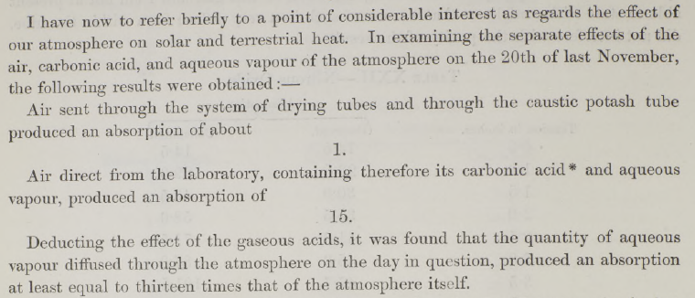
TYNDALL 1859:
AIR CONTAINING CO2 AND WATER VAPOR ABSORBS
15 TIMES THE RADIATION ABSORBED BY AIR
WITHOUT CO2 and WATER VAPOR.

Slide 19
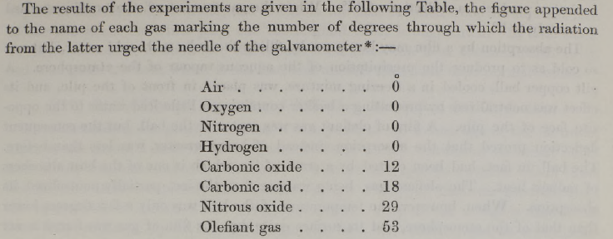
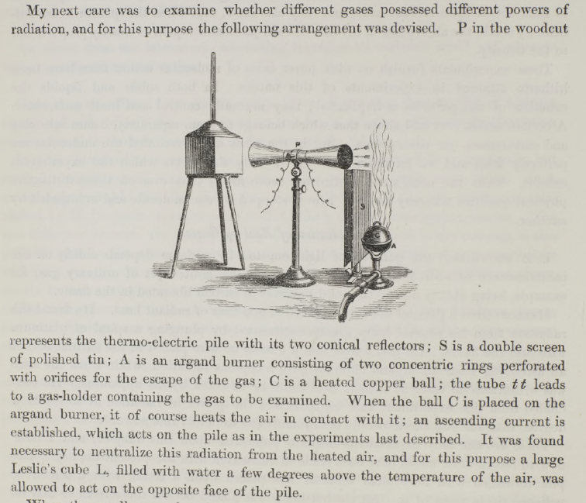
TYNDALL 1859:
GASES THAT ABSORB LONGWAVE RADIATION
ALSO RADIATE LONGWAVE RADIATION.
NITROUS OXIDE, CO2, CARBON MONOXIDE, anD ETHYLENE
ARE ABSORB LONGWAVE RADIATION,
BUT OXYGEN, NITROGEN AND HYDROGEN DO NOT.

Slide 20
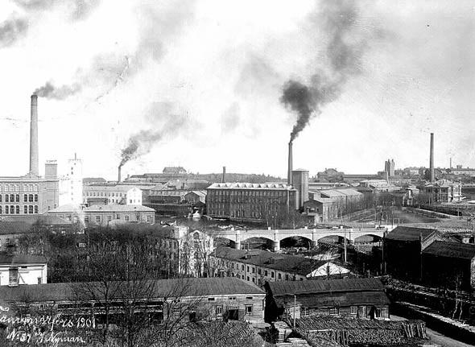
1896
Swedish chemist Svante Arrhenius recognized that burning coal could increase carbon dioxide and warm the climate. He estimated how much carbon dioxide the ocean could absorb. In an 1896 lecture, Arrhenius noted that it was not yet possible to calculate how fast temperature was rising. He also speculated that warming would be beneficial as people in the future "might live under a milder sky and in less barren surroundings."
CONNECTING COAL, CARBON DIOXIDE, AND CLIMATE
https://scied.ucar.edu/learning-zone/how-climate-works/history-climate-science-research

Slide 21
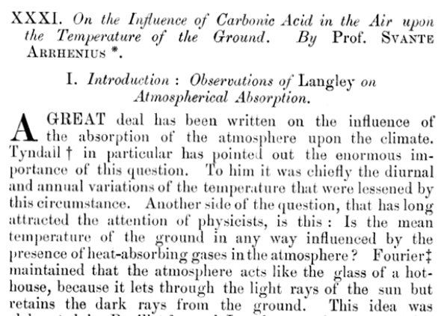
ARRHENIUS 1896:
ABSORBING GASES MODERATE DAY-NIGHT TEMPERATURE CYCLES.
DO THEY ALSO AFFECCT THE TEMPERATURE OF THE EARTH?
FOURIER SUGGESTED “YES” BECAUSE ABSORBING GASES ACT LIKE THE GLASS IN A GREENHOUSE,
LETTING SHORTWAVE RADIATION IN,
BUT IMPEDING ESCAPE OF ENERGY TO SPACE.

Slide 22
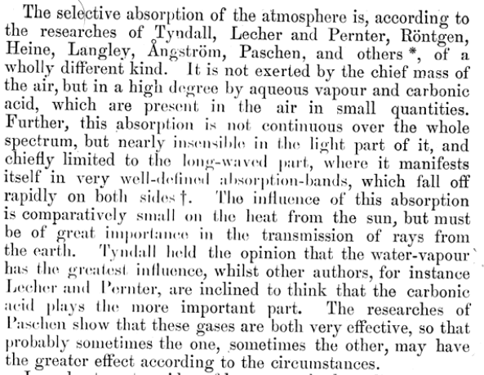
ARRHENIUS 1896:
CO2 AND WATER VAPOR DO NOT PREVENT VISIBLE SUNLIGHT
FROM REACHING THE GROUND.
CO2 AND WATER VAPOR DO PREVENT LONGWAVE RADIATION
FROM ESCAPING TO SPACE.

Slide 23
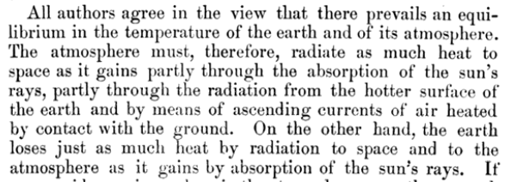
ARRHENIUS 1896:
THE EARTH IS IN ENERGY BALANCE.
LONGWAVE RADIATION TO SPACE
BALANCES
SHORTWAVE RADIATION FROM THE SUN.

Slide 24
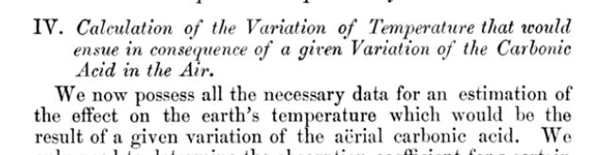
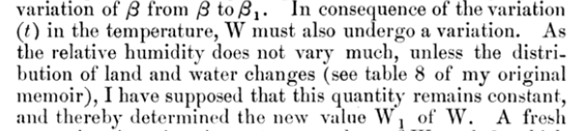
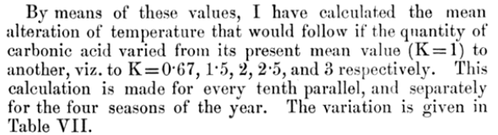
ARRHENIUS 1896:
LET’S ASSUME THAT RELATIVE HUMDITY REMAINS
RELATIVELY CONSTANT AS EARTH’S TEMPERATURE CHANGES

Slide 25
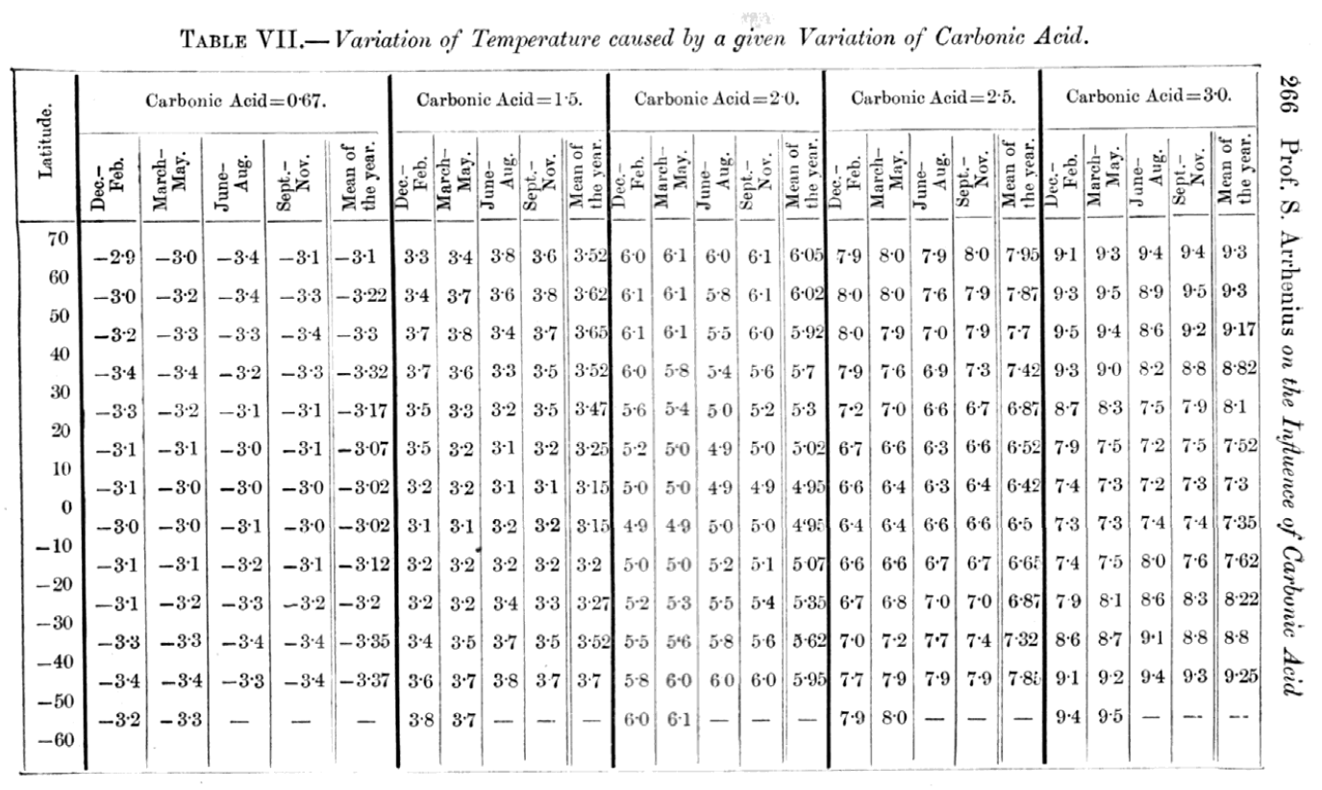
ARRHENIUS 1896: A DOUBLING OF ATMOSPHERIC CO2 CAUSES ABOUT 5 or 6 DEGREES CELSIUS OF WARMING

Slide 26
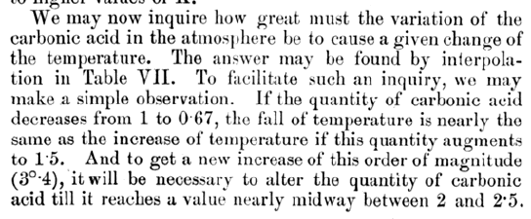
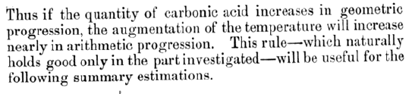
ARRHENIUS 1896:
GLOBAL WARMING INCREASES LINEARLY WITH EACH
HALVING OR DOUBLING OF ATMOSPHERIC CO2 CONTENT.
(THE EARTH WARMS IN PROPORTION TO THE LOGARITHM OF
ATMOSPHERIC CO2 CONTENT.)

Slide 27
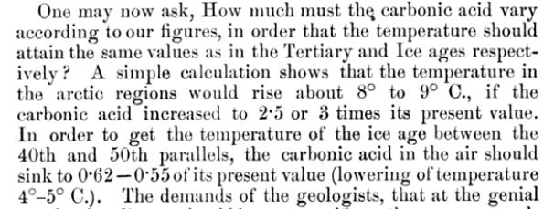
ARRHENIUS 1896:
AN INCREASE OF CO2 oF 2.5 to 3 times from PRE-INDUSTRIAL
WOULD BE ENOUGH TO MELT ICE-CAPS.
A DECREASE TO 0.62 to 0.55 TIMES
WOULD BE ENOUGH TO EXPLAIN ICE AGE.
(MODERN CALCULATIONS SUGGEST 2.5 to 3 TIMES IS ENOUGH TO MELT MOST OF GREENLAND, BUT NOT ANTARCTICA.)
(ICE AGE CO2 was ABOUT 65% OF PRE-INDUSTRIAL CO2.)

Slide 28
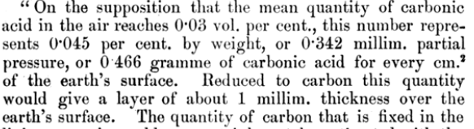
ARRHENIUS 1896:
IF THE CARBON IN ALL OF THE CO2 IN THE ATMOSPHERE
WERE IN A SOLID LAYER COVERING THE EARTH,
IT WOULD ONLY BE 1 MM THICK.

Slide 29
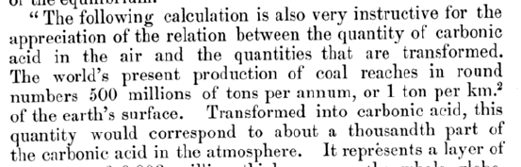
ARRHENIUS 1896:
THE BURNING OF COAL ADDS ENOUGH CO2 TO THE ATMOSPHERE
TO DOUBLE ATMOSPHERIC CO2 CONCENTRATION IN 1000 YEARS.

Slide 30
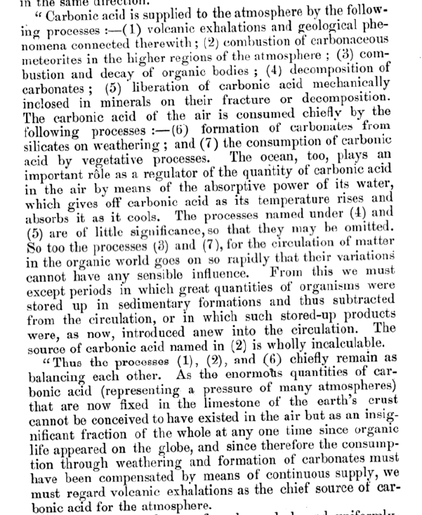
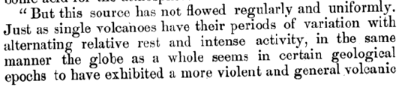
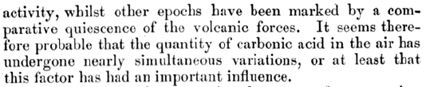
ARRHENIUS 1896:
CO2 MAINLY ADDED TO THE ATMOSPHERE BY VOLCANOS.
CO2 MAINLY REMOVED FROM THE ATMOSPHERE
BY SILICATE-ROCK WEATHERING
AND SUBSEQUENT CARBONATE DEPOSITION.
VARIATIONS IN VOLCANIC ACTIVITY MAY EXPLAIN
CLIMATE VARIATIONS IN THE GEOLOGIC PAST.

Slide 31
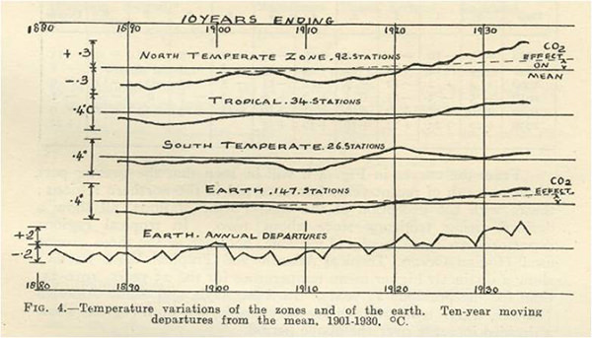
1938
British coal engineer George Callendar compiled all carbon dioxide measurements made over the previous 100 years and found that the amount of CO₂ was increasing. He also found that temperatures were rising. His conclusion was that this was a good thing, that “the return of the deadly glaciers should be delayed indefinitely.”
INCREASING CARBON DIOXIDE AND INCREASING TEMPERATURES
https://scied.ucar.edu/learning-zone/how-climate-works/history-climate-science-research

Slide 32
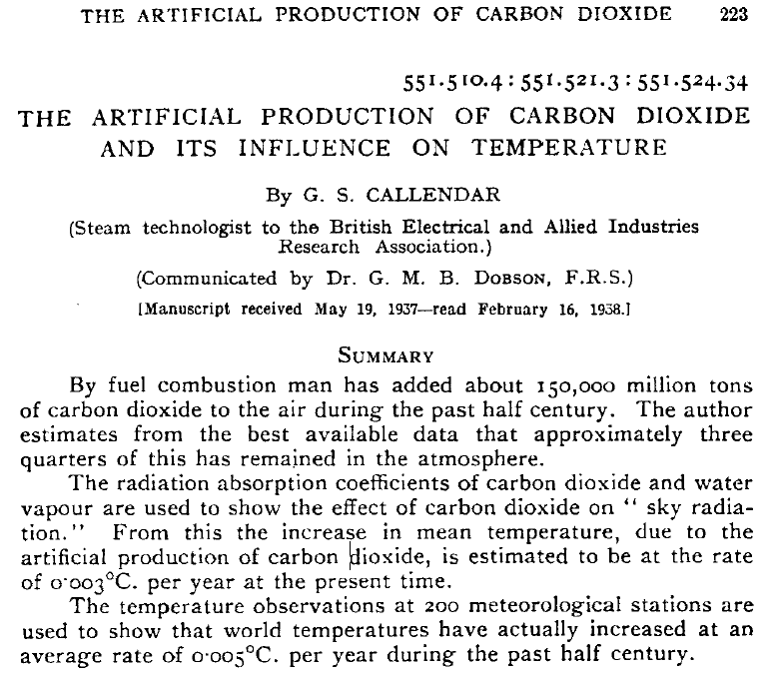
CALLENDAR 1938:
INCREASE IN ATMOSPHERIC CO2 CONTENT
LIKELY RESPONSIBLE FOR
OBSERVED GLOBAL WARMING.

Slide 33
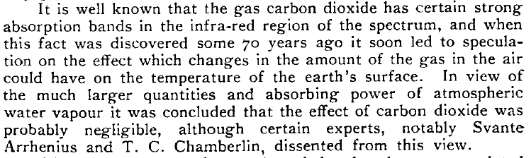
CALLENDAR 1938:
INCREASE IN ATMOSPHERIC CO2 CONTENT
LIKELY RESPONSIBLE FOR
OBSERVED GLOBAL WARMING.

Slide 34
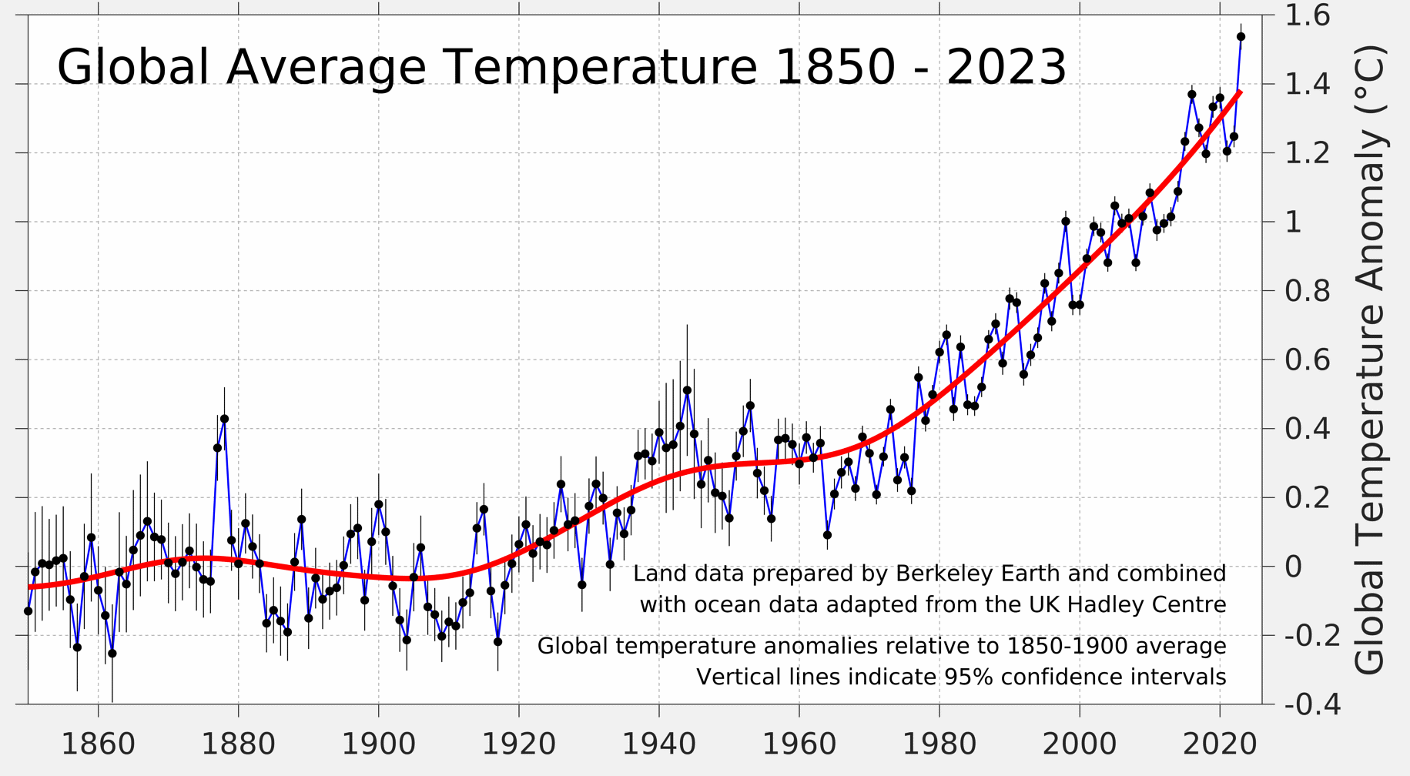
CALLENDAR 1938:
ACTUAL INCREAE 1888-1938 CLOSER TO 0.2 °C.
PROBABLY NOT STATISTICALLY SIGNIFICANT.
https://berkeleyearth.org/global-temperature-report-for-2023/

Slide 35
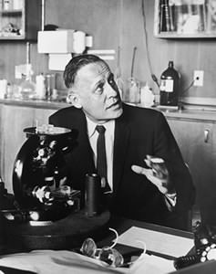
1956
Gilbert Plass writes a review paper on “The Carbon Dioxide Theory of Climat Change”. Concludes that “The extra CO, released into theatmosphere by industrial processes and other human activities may have caused the temperature rise” and “that this warming trend will continue, at least for several centuries.”
THE CARBON DIOXIDE THEORY OF CLIMATE CHANGE
https://scied.ucar.edu/learning-zone/how-climate-works/history-climate-science-research

Slide 36
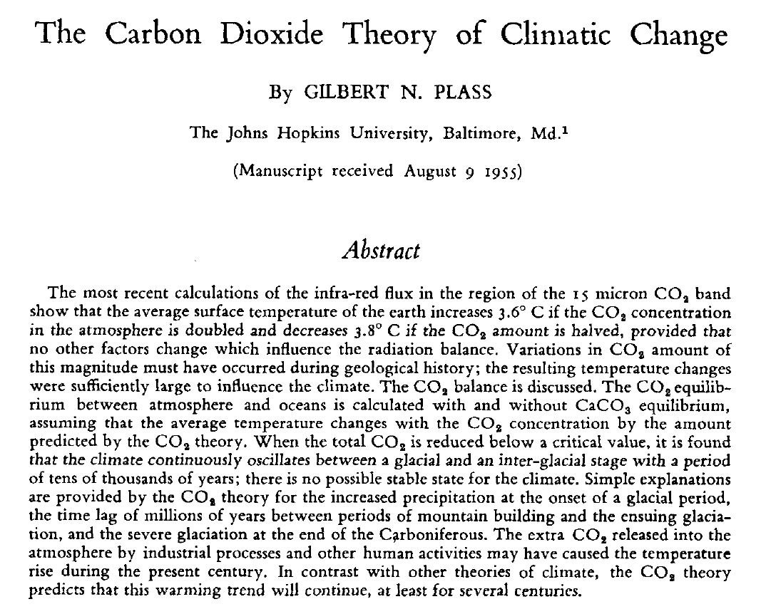
PLASS 1956:
3.6 °C warming per CO2 doubling.
INDUSTRIAL PROCESSES MAY HAVE CAUSED
EARTH TO WARM.
WARMING TREND WILL CONTINUE
FOR CENTURIES.

Slide 37
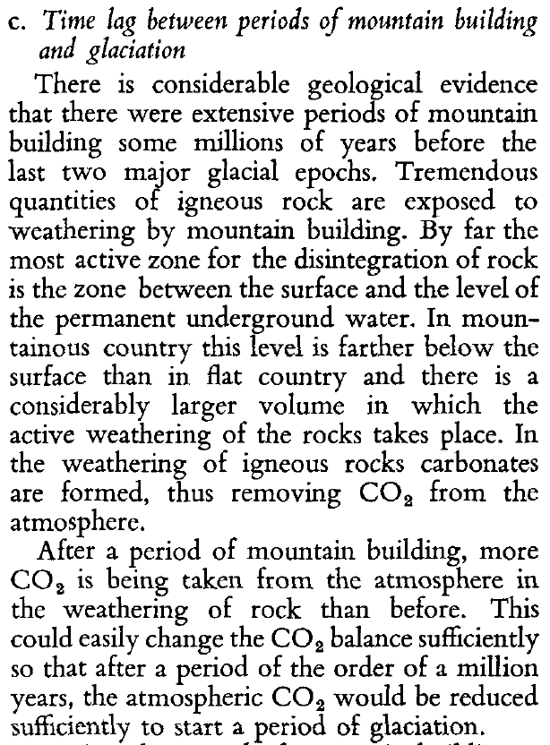
PLASS 1956:
MOUNTAIN-BULDING INCREASES WEATHERABILITY OF SILICATE ROCKS, CAUSING CO2 TO BE REMOVED FROM THE ATMOSPHERE, COOLING THE EARTH.

Slide 38
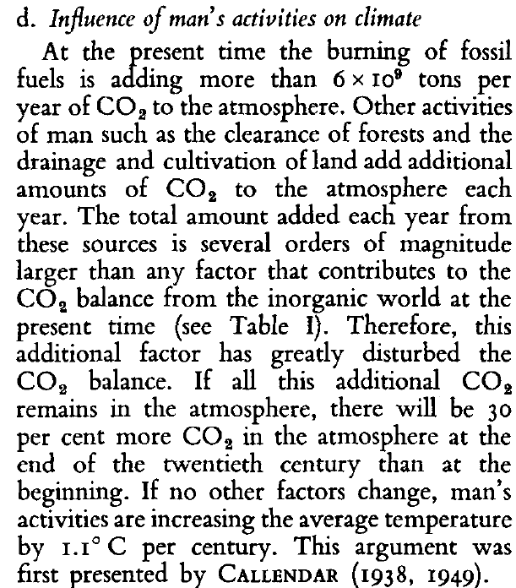
PLASS 1956:
FOSSIL FUELS A MAJOR SOURCE OF CO2 RELATIVE TO THE NATURAL INORGANIC CARBON CYCLE.
CO2 WILL INCREASE BY 30% and 1.1 °C WARMING BETWEEN 1900 AND 2000.
(ACTUAL INCREASE WAS 26% AND 0.7 °C .)

Slide 39
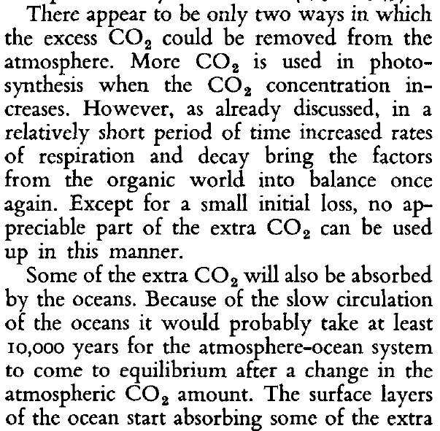

PLASS 1956:
CO2 REMOVED BY LAND BIOSPHERE.
CO2 REMOVED BY THE OCEANS.
OCEANS WILL LIKELY TAKE UP ONLY
A SMALL FRACTION OF EXCESS ATMOSPHERIC CO2

Slide 40
1957
Roger Revelle, U.S. oceanographer, and Hans Suess, Austrian-born U.S. chemist, realizing that carbon dioxide from industrial sources must be building up in the atmosphere, wrote in 1957: “Thus human beings are now carrying out a large scale geophysical experiment of a kind that could not have happened in the past nor be reproduced in the future.”
OUR UNINTENDED EXPERIMENT
https://scied.ucar.edu/learning-zone/how-climate-works/history-climate-science-research

Slide 41

REVELLE 1957:
RADIOCARBON MEASUREMENTS INDICATE THAT MOST CO2 EMITTED IS GOING INTO THE OCEANS.
CONTINUED EXPONENTIAL RISE IN EMISSIONS COULD CAUSE “SIGNIFICANT” INCREASE IN ATMOSPHERIC CONCENTRATION.

Slide 42

REVELLE 1957:
20 to 40% INCREASE IN ATMOSPHERIC CO2 content expected in “THE COMING DECADES”.
SHOULD ALLOW DETERMINATION oF CLIMATE EFFECTS.
ACTUAL: 20% INCREASE BY 1979 AND 40% INCREASE BY 2011
FIRST “DETECTION AND ATTRIBUTION” PUBLISHED IN 1996 (29.3% INCREASE).

Slide 43


REVELLE 1957:
SEAWATER CHEMISTRY MEANS THAT A 1% INCREASE IN INORGANIC C CONCENTRATION
LEADS TO A 10% INCREASE IN CO2 PARTIAL PRESSURE.
CALCULATIONS SUGGEST A 3 to 6% iNCREASE IN Co2 DUE
TO FOSSIL-FUEL BURNING.
ACTUAL: ACTUAL INCREASE TO 1957 WAS CLOSER TO 11% BUT AT THAT POINT
MORE CO2 HAD BEEN RELEASE FROM LAND-USE CHANGE THAN FOSSIL-FUEL BURNING.

Slide 44
1958
The Bell Telephone Science Hour addressed how our actions could be changing Earth’s climate. “Even now, [we] may be unwittingly changing the world's climate through the waste products of [our] civilization,” said the narrator. “Due to our release from factories and automobiles every year of more than six billion tons of carbon dioxide, which helps the air absorb heat from the Sun, our atmosphere seems to be getting warmer.”
https://www.youtube.com/watch?v=EbHYcNtcW7g
https://youtu.be/EbHYcNtcW7g?t=2997s
CLIMATE SCIENCE ON TELEVISION
https://scied.ucar.edu/learning-zone/how-climate-works/history-climate-science-research

Slide 45
1958
Charles Keeling started making daily measurements of the amount of carbon dioxide in the air atop Mauna Loa in Hawaii. That first March day, he found 313 parts per million (ppm) of carbon dioxide in the air. The measurements, which are still made each day, reached 400 ppm on May 9, 2013, and continue to climb.
https://youtu.be/rEbE5fcnFVs
DAILY MEASUREMENTS OF CARBON DIOXIDE
https://scied.ucar.edu/learning-zone/how-climate-works/history-climate-science-research

Slide 46

KEELING 1960:
SEASONAL CYCLE OF CO2 IN NORTHERN HEMISPHERE IS AN INDICATOR OF PHOTOSYNTHESIS AND RESPIRATION.
INCREASE SEEN AT SOUTH POLE COULD BE DUE TO FOSSIL-FUEL BURNING.

Slide 47


KEELING 1960:
SEASONAL CYCLE OF CO2 IN NORTHERN HEMISPHERE IS AN INDICATOR OF PHOTOSYNTHESIS AND RESPIRATION.
RATE OF CO2 INCREASE AT SOUTH POLE INDICATES LITTLE OCEAN CO2 UPTAKE.

Slide 48




Slide 49


TELLER 1960:
“… A MORE HYPOTHETICAL DIFFICULTY WHICH I THINK IS QUITE PROBABLY GOING TO TURN OUT TO BE REAL.”

Slide 50

TELLER 1960:
“I THINK THIS CHEMICAL CONTAMINATION IS MORE SERIOUS THAN MOST PEOPLE TEND TO BELIEVE.”

Slide 51

TELLER 1960:
SEARCH FOR NEW FUELS TO ADDRESS CLIMATE RISK.

Slide 52

PSAC 1965:
FIRST TIME A US PRESIDENT WAS WARNED OF CLIMATE RISK.

Slide 53


PSAC 1965:
FIRST TIME A US PRESIDENT WAS WARNED OF CLIMATE RISK.
NOW, a 25% increase is expected
to CAUSE ABOUT 1°C OF WARMING.

Slide 54

PSAC 1965:
CO2 MAY INCREASE BY 25% BY YEAR 2000.
ACTUAL INCREASE TO YEAR 2000 WAS 32%.

Slide 55

PSAC 1965:
WARMING MIGHT BE COUNTERACTED
WITH REFLECTIVE PARTICLES
OR BY MODIFYING CIRRUS CLOUDS.
NO MENTION OF TRYING TO DECREASE EMISSIONS.

